Slide 1
ARSHIK S
HandWritten Digit Recognition Using CNN
730321104005
III – CSE
Builders Engineering College

Slide 2
HandWritten Digit Recognition Using CNN – Convolutional Neural Networks

Slide 3
AGENDA
Introduction to Handwritten Digit Recognition and CNN.
Exploring the MNIST dataset.
Preprocessing the data
Splitting the dataset into training, validation, and testing sets.
Building a simple CNN model using Keras.
Training the CNN model on the training dataset.
Evaluating the model's performance on the validation dataset.
Fine-tuning the model based on validation results.
Evaluating the final model on the test dataset.
Visualizing model predictions and errors.

Slide 4
PROBLEM STATEMENT
The objective of this project is to develop a CNN-based system capable of accurately recognizing handwritten digits from the MNIST dataset (or any other suitable dataset). The system should be able to correctly classify digits ranging from 0 to 9 with high accuracy.

Slide 5
PROJECT OVERVIEW
Handwritten digit recognition is a classic problem in the field of pattern recognition and computer vision. It involves the identification of handwritten digits from 0 to 9, often in the context of scanned documents, digital pen input, or postal automation. Convolutional Neural Networks (CNNs) have emerged as a powerful tool for addressing this problem due to their ability to learn hierarchical representations directly from raw pixel data.

Slide 6
WHO ARE THE END USERS?
Researchers and Developers
Educational Institutions
Software Developers
Government Agencies
Medical Institutions
Legal and Administrative Services

Slide 7
YOUR SOLUTION AND ITS VALUE PROPOSITION
Our solution leverages Convolutional Neural Networks (CNNs) to accurately recognize handwritten digits from 0 to 9 with high precision and efficiency. By employing state-of-the-art deep learning techniques, we have developed a robust system capable of handling diverse writing styles, variations, and noise commonly encountered in handwritten data.
VALUE PROPOSITION:
High Accuracy and Reliability
Efficiency and Scalability:
Automation and Workflow Optimization
Adaptability and Customization:

Slide 8
THE WOW IN YOUR SOLUTION
Superior Accuracy and Precision
Real-time Performance:
Adaptability to Varied Inputs:
User-friendly Interface:
Cross-domain Applicability:
Continuous Learning and Improvement:
Scalability and Efficiency:

Slide 9
MODELLING
Data Preparation
Designing CNN Architecture
Adding Convolutional Layers
Adding Pooling Layers
Flattening and Adding Fully Connected Layers
Output Layer and Activation
Model Compilation
Training the Model
Hyperparameter Tuning
Model Evaluation
Model Optimization
Model Deployment

Slide 10
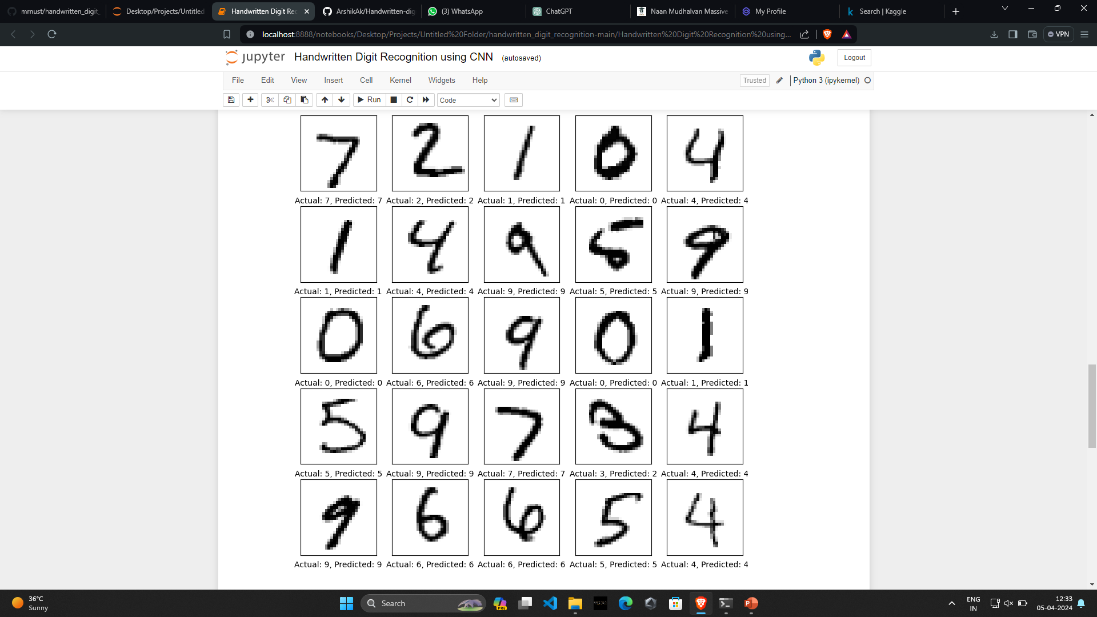
RESULT

